Slide 1
Project #1: Analysis of patients with Cardiovascular diseases
Data source: https://www.kaggle.com
The original CSV file includes 14 columns and 1,025 rows of data
Mari Awaisi

Slide 2
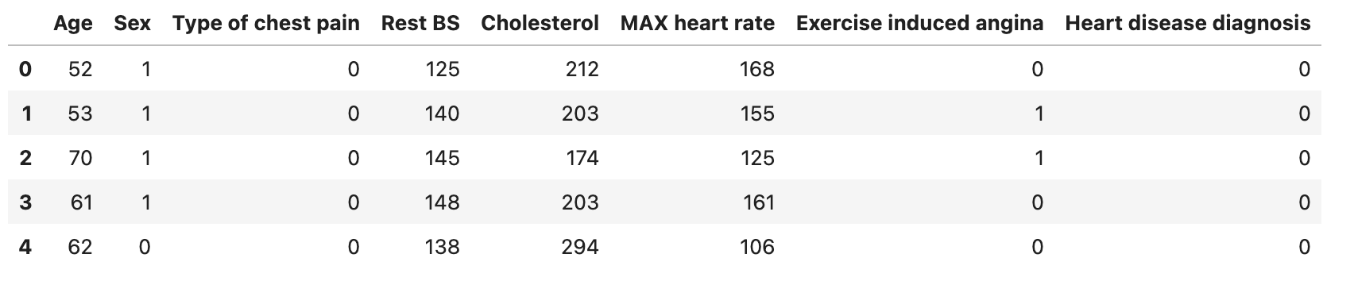
Data introduction
The original CSV file includes 14 columns and 1,025 rows of data.
Cleaned DataFrame includes 8 major columns, that have been used in the Project analysis:
Age: Age of patients
Sex: Sex of patients where 1 = male, 0 = female
Type of chest pain: Types of chest pain experienced by patients where 0 = typical angina, 1 = atypical angina, 2 = non-angina pain, 3 = asymptomatic
Resting BS: Resting blood pressure of patients (in mm Hg)
Cholesterol: Cholesterol level of patients in mg/dl
MAX Heart rate: MAX heart rate of patients
Exercise induced angina: Angina caused by exercise, where 1 = yes and 0 = no
Heart disease diagnosis: Patients with heart disease (0 = yes) and without (1 = no)

Slide 3
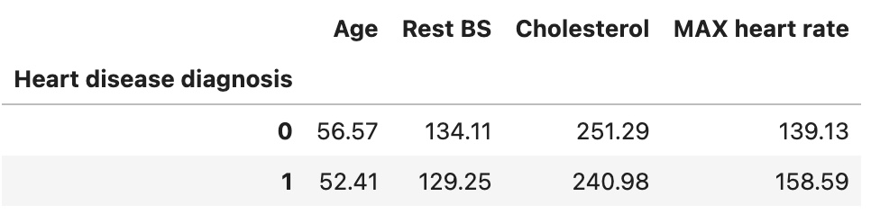
Mean values of key metrics:
1 - patients w/o Heart disease, 0 - patients with Heart disease
Patients with cardiovascular diseases in average are tend to be older than rest of researched population and have higher resting heart rate and
cholesterol level.
However, their maximum heart rate doesn’t fluctuate much for the resting rate, comparing to patients without any heart conditions.

Slide 4
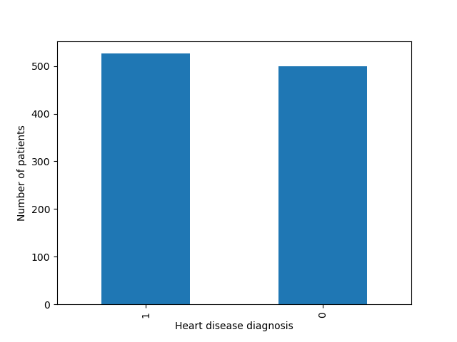
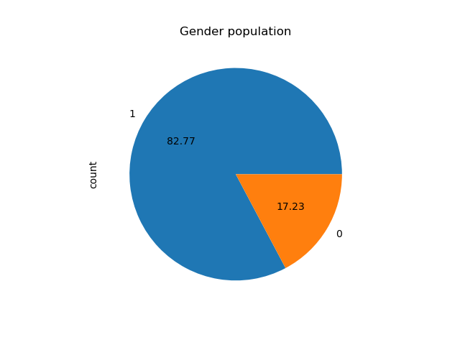
Plot gender population of patients with Heart disease conditions
1 - patients w/o Heart disease, 0 - patients with Heart disease
1 - male patients, 0 - female patients
Number of patients with Heart disease conditions: 499;
Number of patients w/o Heart disease conditions: 526;

Slide 5
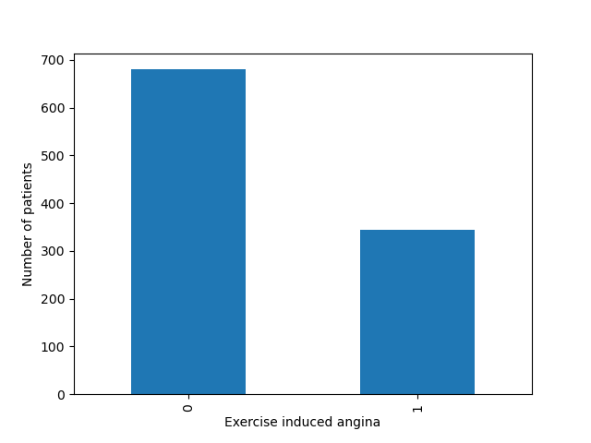
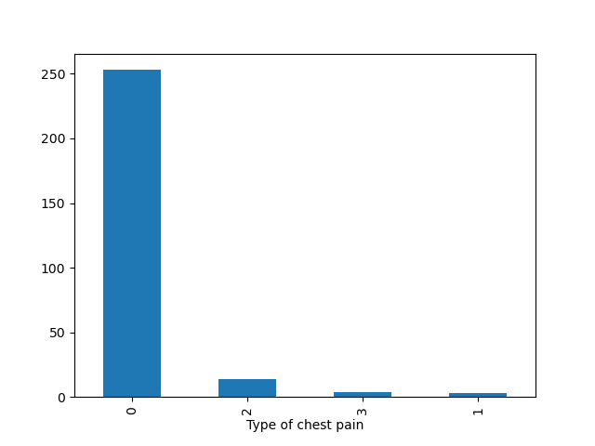
Plot bar charts of patients with angina caused by exercise or not
Plot chart of patients by chest pain types with heart disease conditions and with non-exercise induced angina
Exercise induced angina: Angina caused by exercise,
where 1 = yes and 0 = no
Type of chest pain: Types of chest pain experienced by patients,
where 0 = typical angina, 1 = atypical angina,
2 = non-angina pain, 3 = asymptomatic

Slide 6
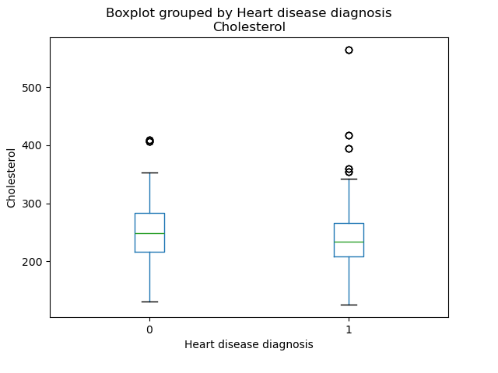
Group patients with and without heart disease conditions, plot with reference to patients’ Cholesterol level
The right box plot represents patients w/o any Heart disease and
It is located slightly lower on the graph comparing to 0-patients.
In addition to that there are more outliers on the

Slide 7
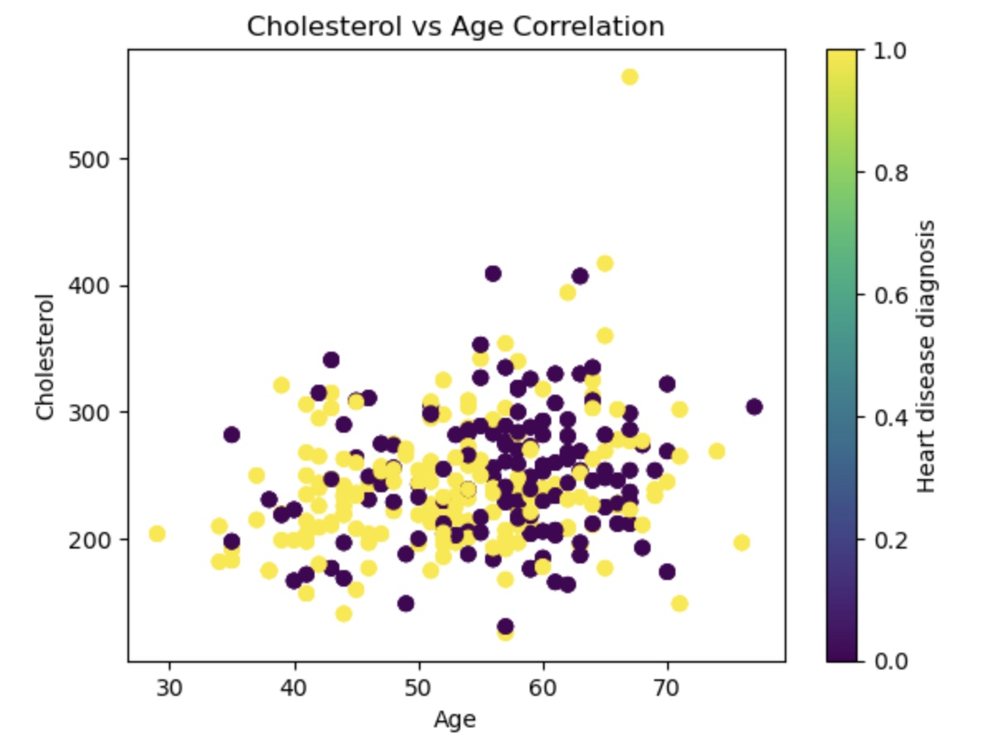
Create a scatter plot of patients population age correlated to the cholesterol level
Purple dots represent patients with Heart disease (0) and Yellow dots
on the other side categorise people without any heart
disease conditions

Slide 8
Conclusion
Males are at higher risk of getting cardiovascular diseases.
Out of 499 patients participated in the study, nearly 83% were males who had Heart disease conditions.
All 1025 patients were selected for the study as they experienced chest pain. Plot on the slide 5 showed that the majority of patients had non-exercise induced angina and over 90% of them had a typical angina, that is one of the symptoms of myocardial ischemia or other cardiovascular diseases.
Cholesterol level of patients wasn’t an obvious factor to conclude whether it triggers or not heart disease conditions and required further analysis.
Scatter plot visually represented correlation between patient’s age and their cholesterol level. It appears that patients of 60+ age category had a higher rate of cholesterol level, that supposedly led to cardiovascular disease conditions.

